Slide 1
Coding Kata
Conversion
Decimal -> Roman

Slide 2
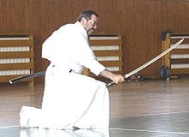

Kata
They could kick ass
But Kata is solo work
Just to show technique
wikipedia: Kata originally were teaching and training methods by which successful combat techniques were preserved and passed on.

Slide 3
Code Kata
Quick work - a few hours, one day, etc..
Developers do katas to learn and practice new development processes or techniques.
e.g. at Agile conferences
Yeah, the problem to be solved is simple.

Slide 4

Code Kata
I know, you could code a working solution in 2 min with no keyboard, using only Jedi powers.
Solving the problem per se is NOT the point of the exercise.
15 years before ITA

Slide 5

Code Kata - the point
Try the development process in practice
Just reading the book is too boring… zzzz….
Is it easier to learn “by doing”?
Practice with a simple problem
learn the rules, how to organize your thinking.
check if you can manage the process to develop a good, well tested, organized solution in due time.

Slide 6
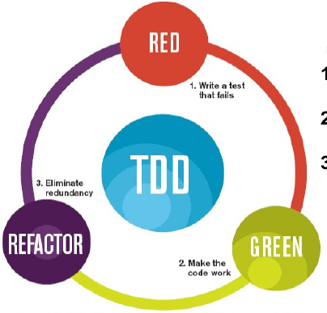
Rules: Basic Cycle
RED: Write a test
today tests are given
Green:
implement the minimum code to pass each test.
Refactor
sometimes you have to rework your code

Slide 7
Rules: you are NOT allowed
You are not allowed to write any production code unless it is to make a failing unit test pass.
You are not allowed to write any more of a unit test than is sufficient to fail; and compilation failures are failures.
You are not allowed to write any more production code than is sufficient to pass the one failing unit test.

Slide 8
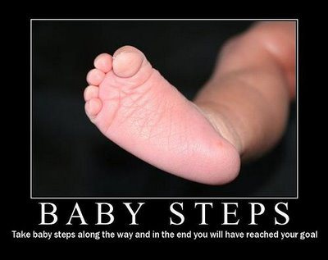
summary of previous rules:

Slide 9
Prioritize changes
Refactoring, strictly speaking:
changes the how, not the what
code does the same thing, only better, with no repeated code, faster, simpler, nicer, smaller, clearer, easier, more extensible, usable, easier to maintain, cuter, etc..
But to go forward you really code new stuff
(but only when making new tests pass)
Let’s call this: “code Transformation”
as opposed to “code refactoring”

Slide 10
Prioritize Transformations
New tests, new functionalities
Strive to find the simplest transformations needed to make the one new test pass
Uncle Bob proposed a list of transformations.
Try to use the simplest (the first) possible ones when implementing new functionality.
The order is not strict, is approximate.

Slide 11
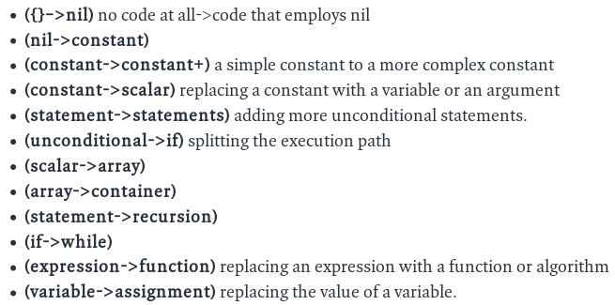

Slide 12
today’s problem
Convert a number (integer value) to a string with its Roman representation
e.g.: 1999 -> MCMXCIX
tests are given. make each one of them pass in order, with baby steps.
the original proposal with other example:
http://blog.8thlight.com/uncle-bob/2013/05/27/TheTransformationPriorityPremise.html

